Slide 1
0x303 – Embedded Linux/Android Firmware & Attacks

Slide 2
Reminder: Why/What?
“Bad” Reasons:
Finding exploit to ransomware devices
Finding exploit to steal information, spy, etc
Recovering some trade secret from the device (algorithm)
“Good” Reasons:
Testing if the device has a backdoor left in it.
We want to extend functionality of our device.
We are making some hardware / accessory and need to understand the protocol.
We are repairing the device.

Slide 3
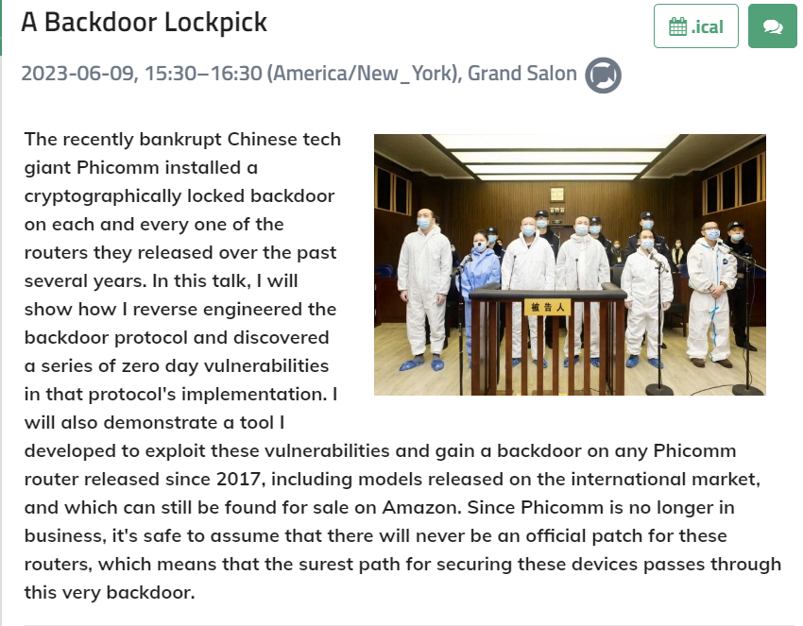
Backdoors – Not Just Empty Threats
https://cfp.recon.cx/2023/talk/JBQEMS/

Slide 4
What: Exploits we might look for:
Easy:
Devices have a fixed root password.
Devices have some open service/port (telnet, ssh, etc).
Devices are running old (vulnerable) versions of software.
We can use CVE databases to help here.
Devices have some firmware update mechanism we can trigger.
Harder
Devices have a custom

Slide 5
Why: Binary Dumping & Getting Root Login
You can do a lot of the above from just looking at the binary.
Especially if mounting the binary on your filesystem.
But binaries compiled for your target won’t work on your host – requires an emulator.
If we can just “login” to the real device we can observe everything!
Also we can interact with any special attached hardware, memory devices, etc

Slide 6
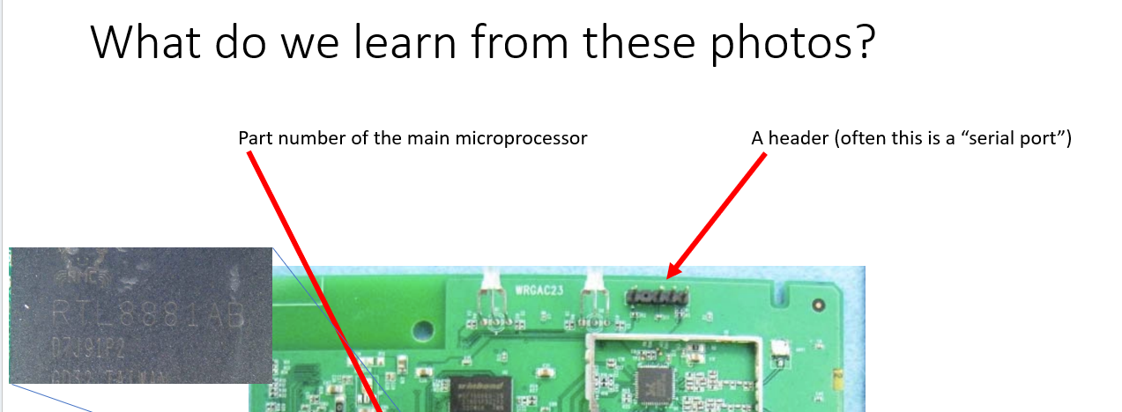
Example: Serial UART on Router from 0x301

Slide 7
Serial Exploration
<Live Demo>

Slide 8
Easy Mode!
No password on the serial port… just plug in & go.
Still sometimes the case, more often you have a login prompt.

Slide 9
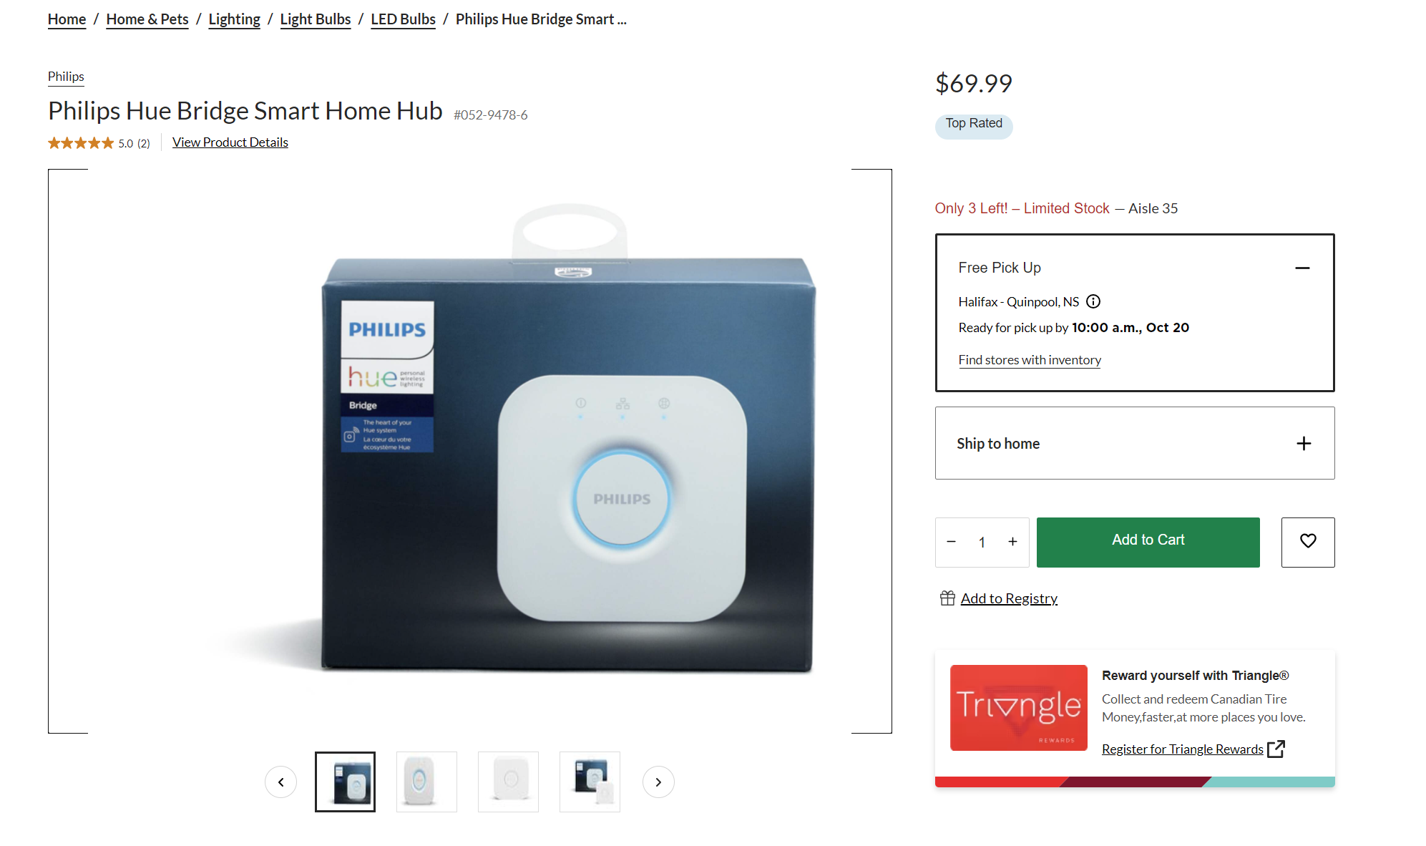
Embedded Linux Example

Slide 10
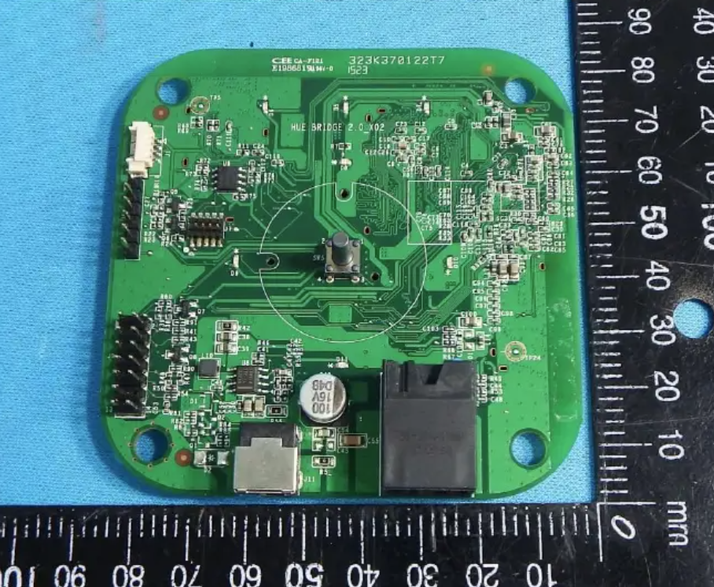
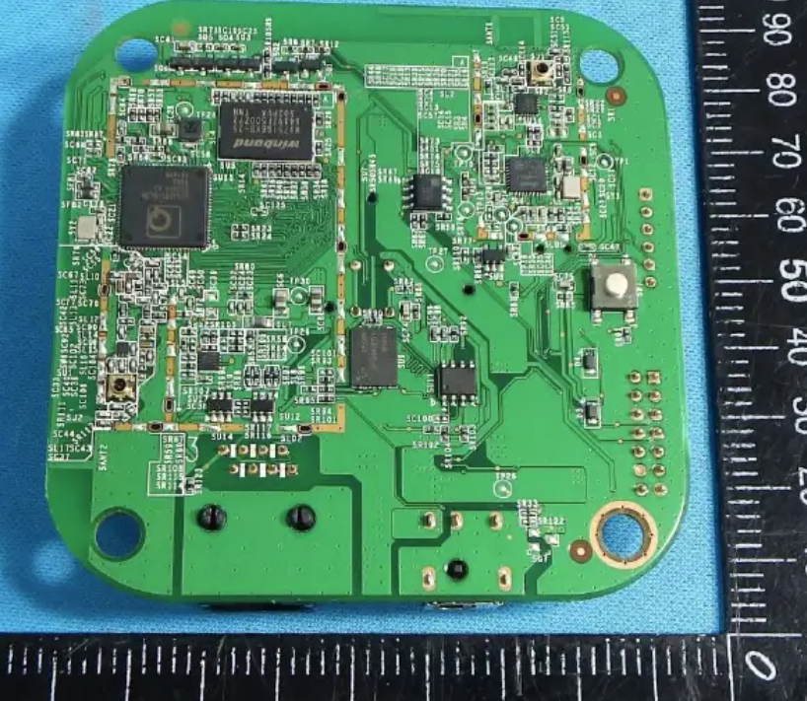
Step 1: FCC Check

Slide 11
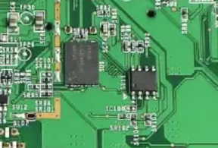
Reminder on Flash Locations
Linux Bootloader
MicroSD card or eMMC (large Flash)
Processor Core
First Stage Bootloader
Boot ROM
Main “SoC” Chip
Small flash chip

Slide 12
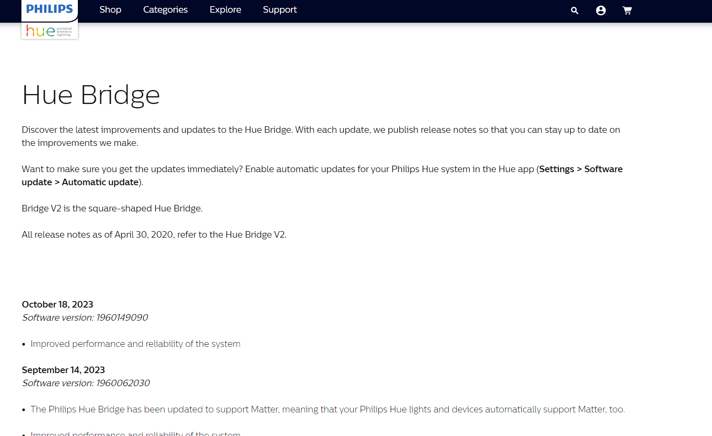
Step 2: Check Firmware Updates
No available updates to download! Device does it automatically.
HINT: If you have a controlled network, you might be able to sniff the firmware update using Wireshark and see if it’s just downloading from some “secret” URL.
This is very common.
But let’s assume no FW update out yet…

Slide 13

Bootloader (Das u-Boot)
Das uBoot (normally just “u-Boot or uBoot) is a very common bootloader for embedded systems.
Similar to your computers BIOS, it does basic setup like:
Configures the main SoC
DDR memory setup
Loads “main” filesystem which contains Linux or other OS

Slide 14
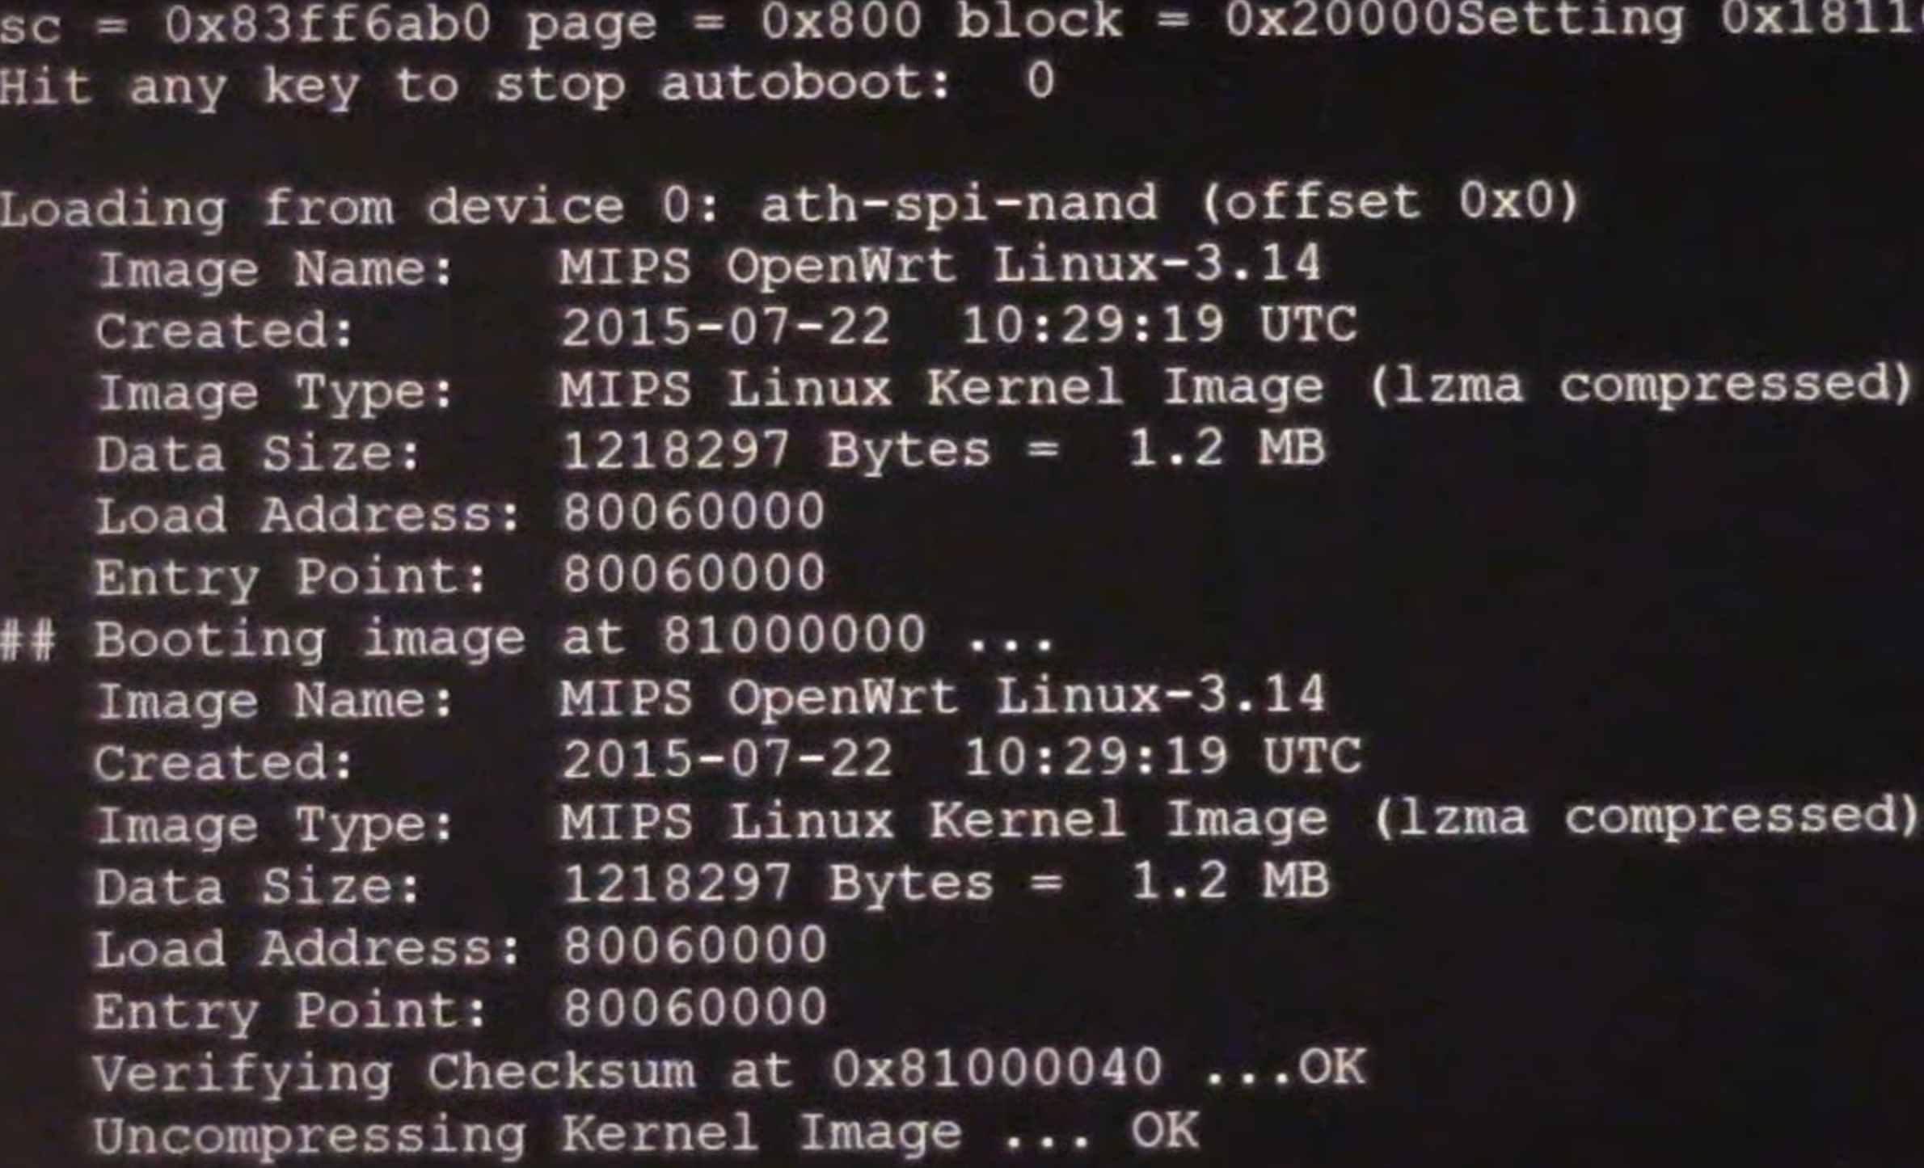
Interrupting Boot – Easy Mode
If we can interrupt the bootloader we get a console which gives us access before the system boots:

Slide 15
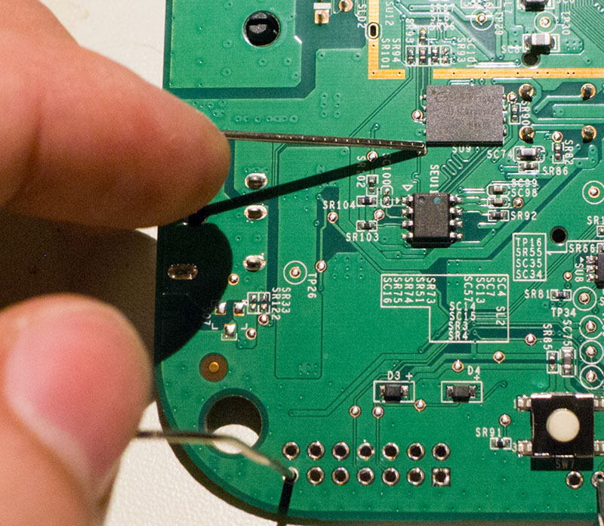
Interrupting Boot – Pin2Pwn
Linux Holding Flash

Slide 16
Note – Following Along
I’ve got more details in a post here: https://colinoflynn.com/2016/07/getting-root-on-philips-hue-bridge-2-0/
This includes the linked video.

Slide 17
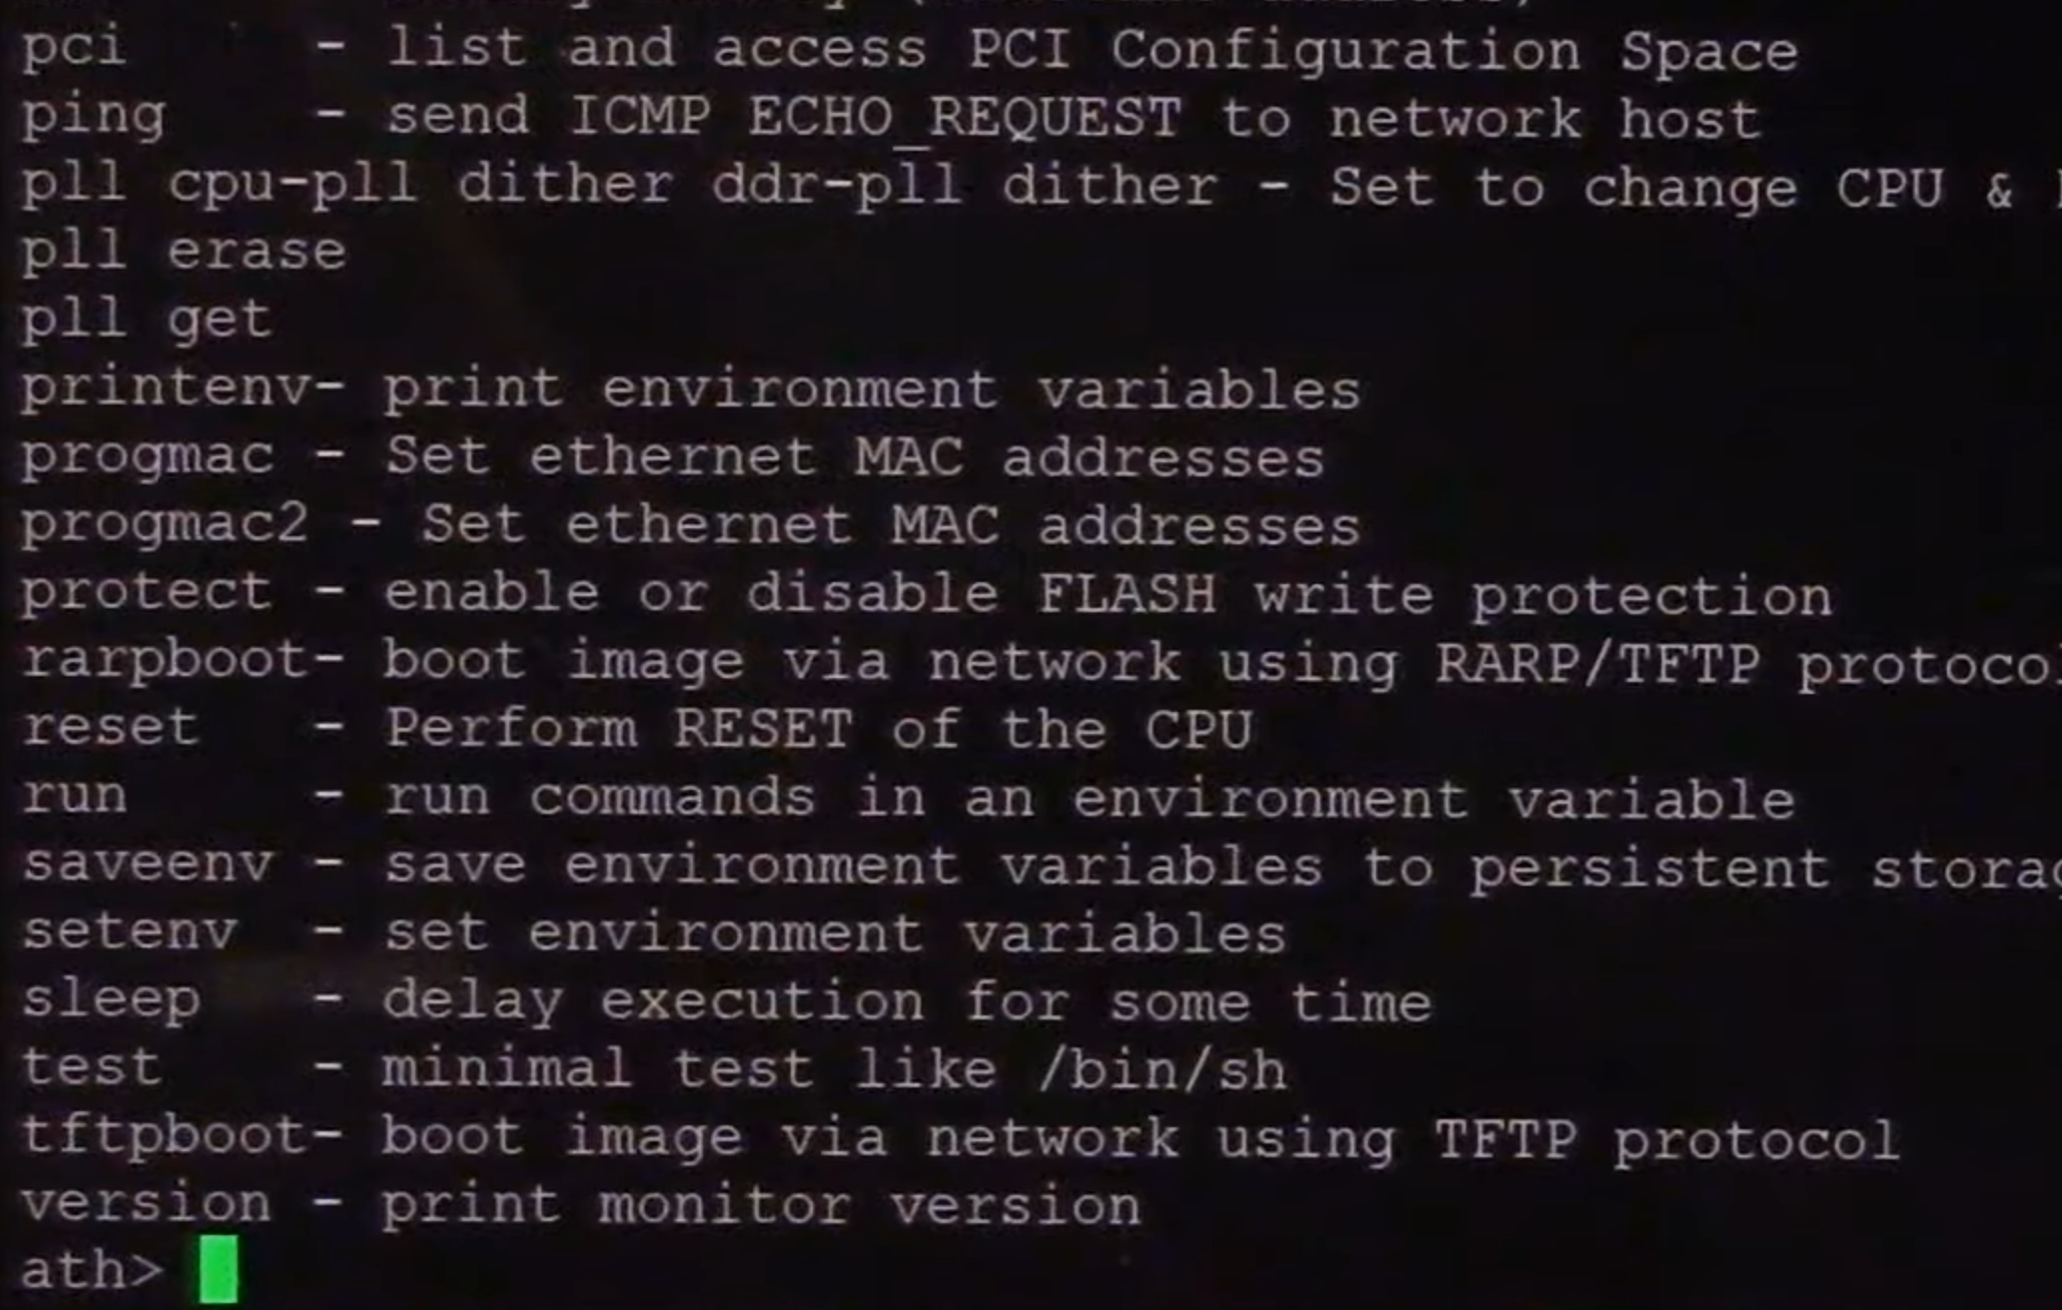
What to do with U-Boot?

Slide 18
Linux Kernel Arguments
Original Linux Kernel Arguments
board=BSB002 console=ttyS0,115200 ubi.mtd=overlay rootfs=/dev/mtdblock:rootfs rootfstype=squashfs
setenv std_bootargs 'board=BSB002 console=ttyS0,115200 ubi.mtd=overlay rootfs=/dev/mtdblock:rootfs rootfstype=squashfs noinitrd init=/bin/sh';
With U-Boot Console, modify like:

Slide 19
Other Options with U-Boot
Depending on what’s available on the system, lots more options! Can use small fileserver to get files across etc. Good blog post here has some examples: https://cybergibbons.com/hardware-hacking/recovering-firmware-through-u-boot/

Slide 20
What does this do?
Device boots as normal.
Once it passes to “init”, it just runs the basic shell at /bin/sh
This shell doesn’t have the login prompt. It’s very limited (annoying to use), but enough to get work done!

Slide 21
Shell → Rewriting Password
In this specific device – it takes the root password from a U-Boot environmental variable.
So we can actually just give ourselves a login prompt!
setenv security '$1$3vGNd7Q3$ISqFeo1VkmQV6nyriUV0V/'

Slide 22
Next Steps
Once we have an easy/persistent root access, next steps might include:
Loading our own software (maybe this is the entire goal!)
Finding out about versions of software.
Looking at firmware update procedure.

Slide 23
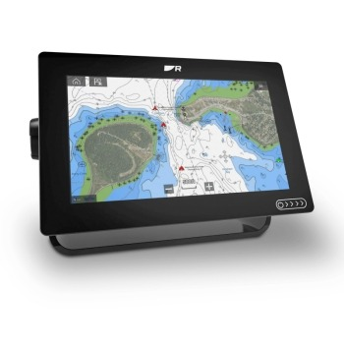
Embedded Android Example
Effectively an Android tablet… but blocks installed “unapproved” apps (not signed by manufacturer).
Can we bypass that restriction?

Slide 24
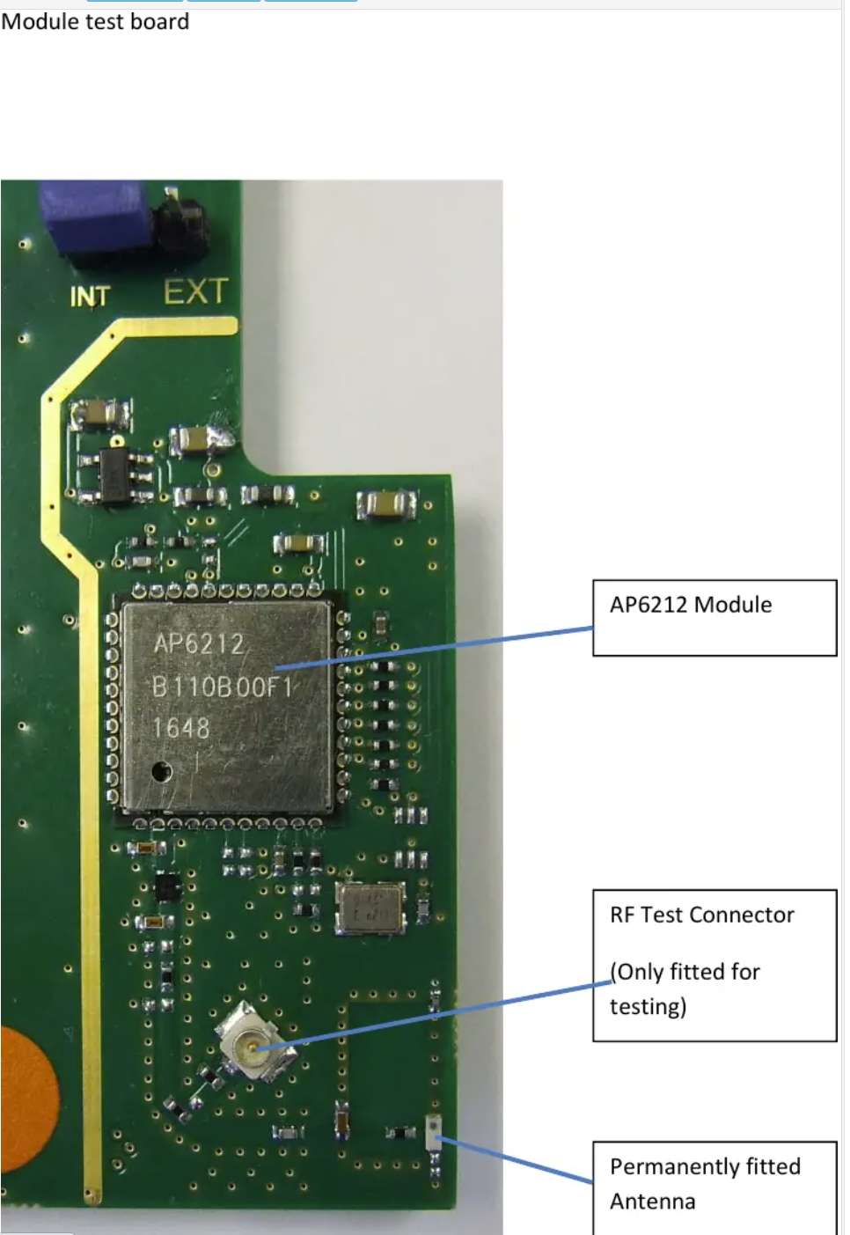
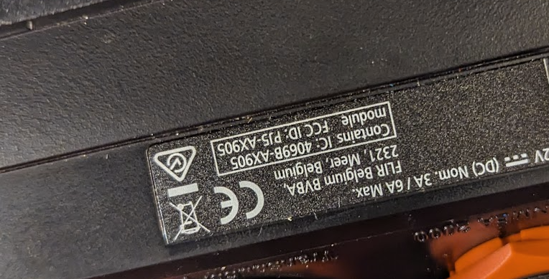
Step 1: FCC-ID

Slide 25
FCC-ID: Modular Approval
Devices may use a RF module. In which case you only see the information about the module itself, NOT the host system.
This isn’t useful for us (unless we wanted to reverse engineering the module).
Note the wording “contains module” or “module FCC-ID”. This will always be present with a modular approval.

Slide 26

Step 2: Firmware Update

Slide 27
Unpacking Firmware Update File
NOTE – if you’re interesting in full details, see:
https://github.com/colinoflynn/raymarine-axiom-rescue
https://www.youtube.com/watch?v=uBnOP4qZgYk

Slide 28
Unpacking Firmware Update File
.zip file
.iso file
.img file
system.img
Standard
Standard
“Rockchip” specific file format.
SquashFS Standard Linux Image

Slide 29
Modifying the Root Filesystem
Now that we have the root filesystem, we want to open a “backdoor”.
Device already had SSH running (confirmed on the device operating normally).
We’ll just add ourselves to the allowed ssh user file!
cat my_axiom_key.pub >> fin/etc/security/authorized_keys.default

Slide 30
Repack Root Filesystem
.iso file
.img file
system.img
Standard
“Rockchip” specific file format.
SquashFS Standard Linux Image

Slide 31
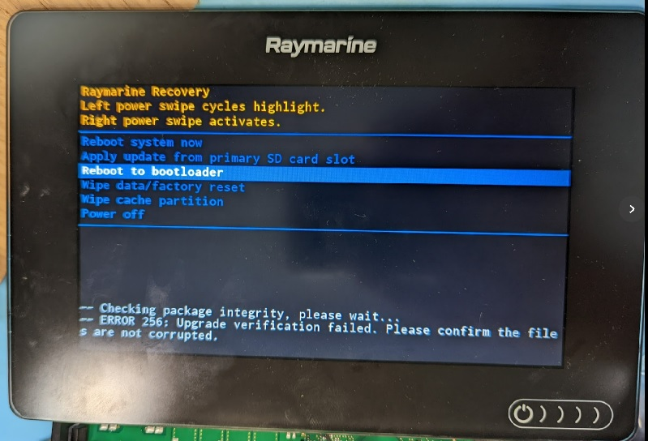
Oops!

Slide 32
“Signing” the Files
#!/bin/bash
MAGIC="?????"
echo "File = $1"
FSIZE="$(stat -c %s $1)"
echo "Size=${FSIZE}"
echo "MD5_Checksum=$(md5sum $1)"
SIG="$(echo -n $MAGIC$FSIZE| cat - $1 | sha256sum - | cut -d' ' -f1)"
echo "SIG_Checksum=${SIG}"
Raymarine has what is effectively a symmetric signing algorithm. The secret key (not shown in this slide, but is on the file you could download) is included alongside the files it is verifying!

Slide 33
Final Attack
With signing algorithm known, can easily recreate the signature & repack the files.
Requires usage of some device-specific tools. These tools are widely available from people doing phone rooting.
In general – when working with android devices, take advantage of all the knowledge of phone rooting users! They are very motivated.

Slide 34
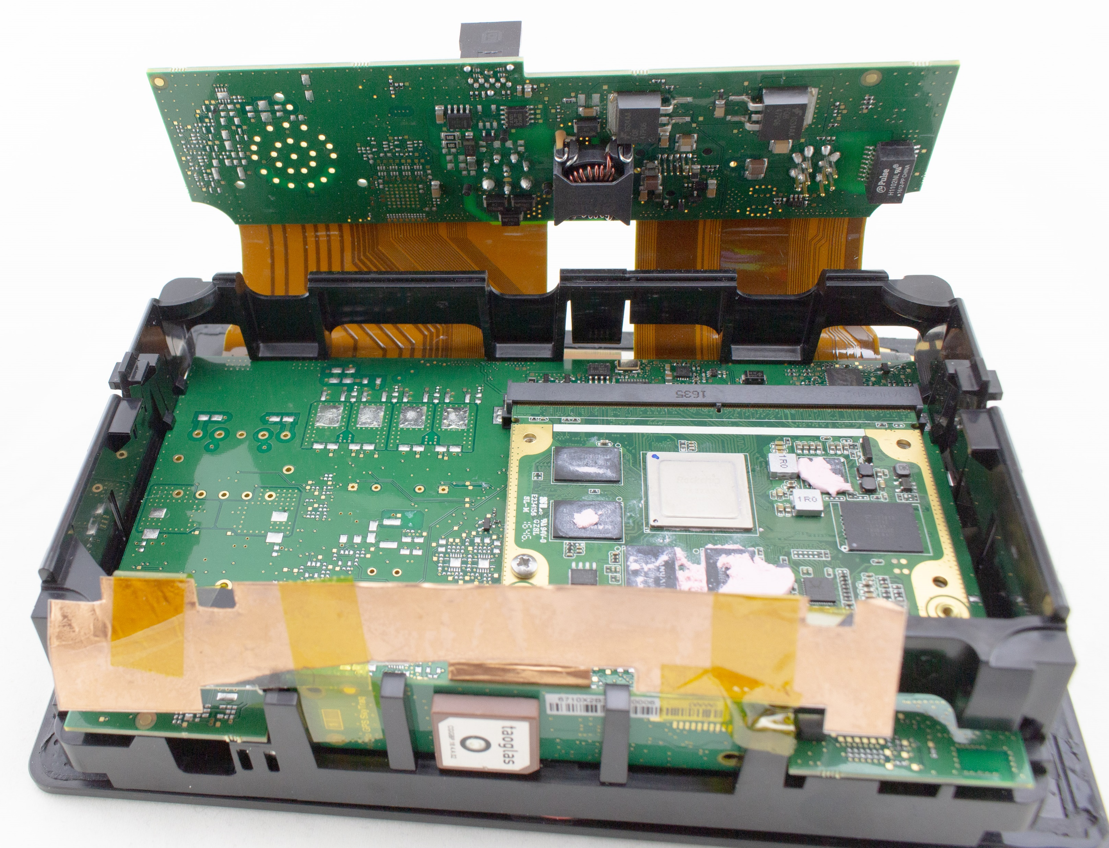

Slide 35
Android Bootloader
Android bootloaders are normally something called fastboot.
I didn’t use the bootloader at all in this attack, but on some devices the bootloader is left “unlocked”.
If you have a USB port on the device, check if that provides Android debugging! Sometimes it is left enabled.
See fastboot documentation, e.g. https://source.android.com/docs/setup/build/running

Slide 36
Summary
IoT devices are often running Android or Linux.
Getting access to the “live” system is often the easiest method of working with it.
Often can mount the filesystem from the device as well, modify it, and rewrite the filesystem back to the device.

